Slide 1
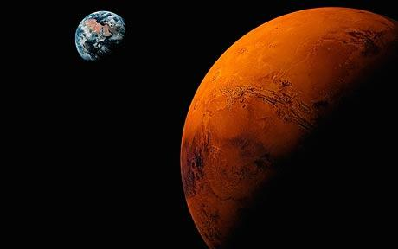
Mineral Analysis of Martian Dunes
By Savannah Bachman Mentor: Dr. Timothy Titus
Universe and planets

Slide 2
Minerals on Dunes
I used thermal infrared observations to determine mineral compositions of six dune fields and their surroundings.
Based off composition of sediment found in the dune and the surroundings, I tested the hypothesis that the sediment came from a localized source.

Slide 3
Outline
Thermal emissions and how to interpret the spectra
Processes used to collect data
  JMARS
  TES
  Speclib
Analysis
  DaVinci
  Mineral composition comparisons
Conclusion

Slide 4
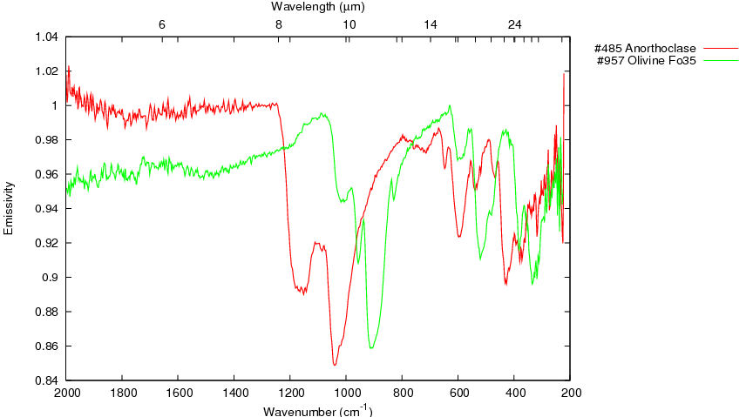
How Spectra works
Emits thermal radiance
Sun
TES
Rock
Radiates heat
Stores heat energy
Collects mineral spectrum
Wavelength µm
Emissivity
Anorthoclase •
Olivine Fo35•
Wavenumber cm⁻¹

Slide 5
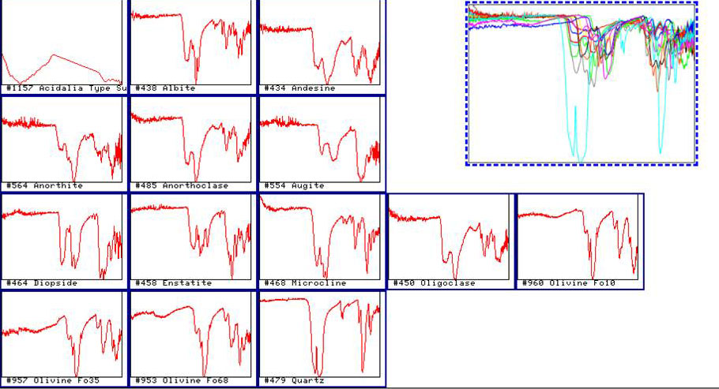
Mineral Spectral Library For this Study
Individual spectra for minerals found on Mars

Slide 6

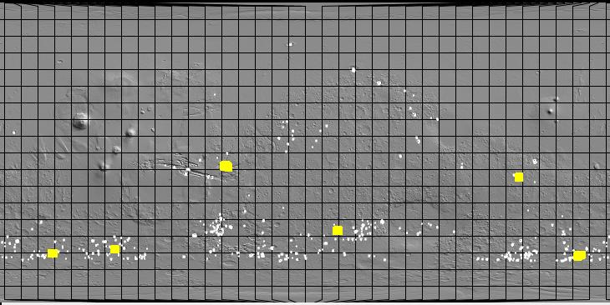
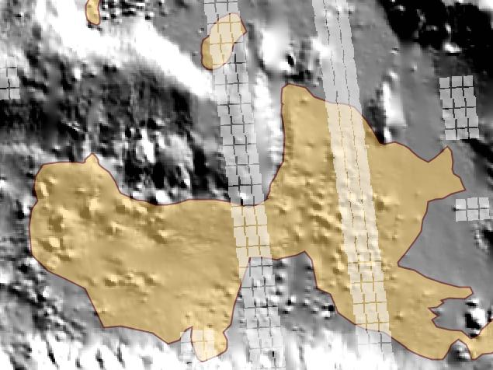
Java Mission-Planning and Analysis for Remote Sensing
180°
0°
-180°
60°
0°
-60°
USGS Dune Database
Dune Selection
  6 dunes total
  Large dunes
  Within equatorial region
Thermal Emission Spectrometer (TES) spectra

Slide 7
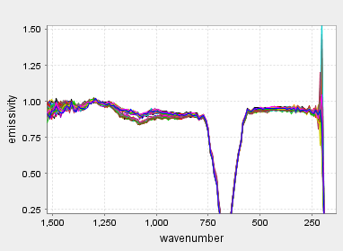
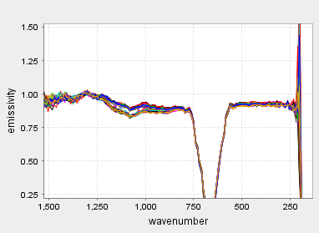
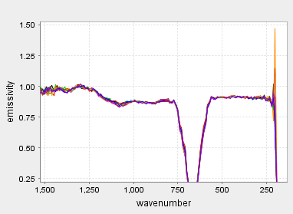
Off the Dune: North
JMARS&TES
CO₂
Dune ID: 3124-080
On Dune
Off Dune: South
Located:
(311.625 E, -7.875)

Slide 8
DaVinci

Slide 9
Mineral Composition Comparison
 | On the Dune | Off the Dune North | Off the Dune South
Olivine Fo35 | 36.01 | 38.85 | 36.21
Microcline | 18.7 | 19.93 | 18.53
Anorthoclase | 12.26 | 13.11 | 11.91
Andesine | 11.92 | 8.91 | 10.97
Diopside | 10.68 | 7.14 | 12.59
Enstatite | 7.4 | 8.36 | 7.24
Quartz | 2.95 | 3.7

Slide 10
Analysis of Mineral Abundance
Three dune fields contain almost no variance in mineral abundance from their surroundings
Two dune fields contain different amounts of olivine and anorthoclase
One dune field contains different amounts of anorthoclase

Slide 11
Local

Slide 12
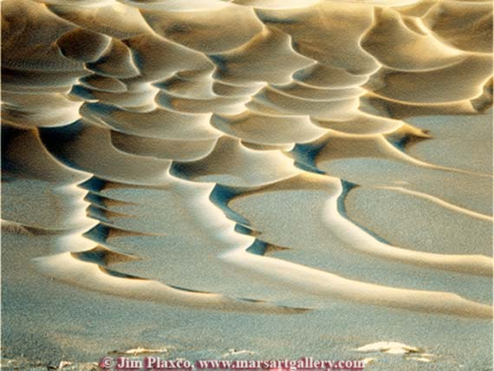
Conclusion
Four dune fields have similar mineral amounts to their surroundings which is indicative of a local sediment source
Two dune fields have different mineral amounts when compared to their surroundings which may suggest a non-localized source

Slide 13
Acknowledgments
Dr. Timothy Titus
Chris Edwards, ASU
Christopher Mount, NAU
Rose Hayward
ASU
NASA Space Grant
Thank you.

